Slide 1



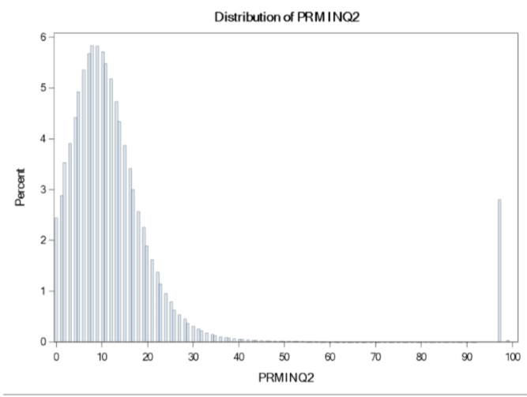
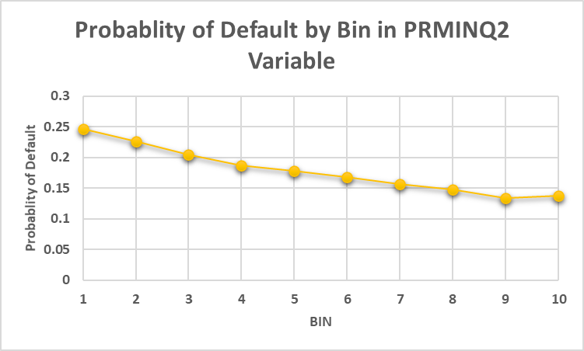
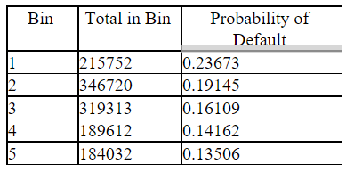
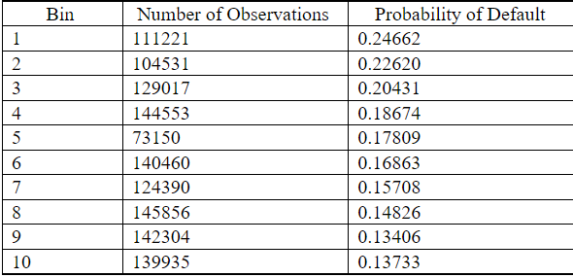
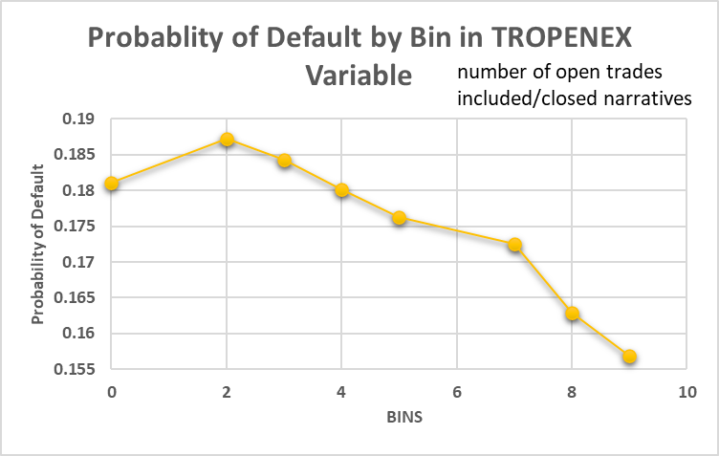
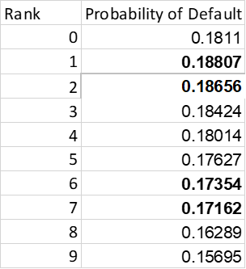
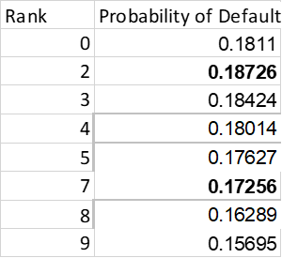
The Discretization Process
Lauren Cohen, Lillian King
INTRODUCTION
Michael Frankel
CONCLUSION
In this process, we explored the discretization processes after the clustering step of our work of calculating if someone desires credit or not. This transforms each variable through the two different discretization processes, discretization 1 and discretization 2. Ultimately, this will allow for the variables to be ranked ordinally by value.
Figure 1. Distribution of PRMINQ2 Variable
Figure 2. Probability of Default by Bin in PRMINQ2 Variable for Discretization Process 2
As we worked to have this dataset used for a model to create a logistic regression, we found this discretization process very helpful. Overall, we saw that, discretization process 2 is easier to use since it is a more automated process having the software SAS to choose the bins for us, but discretization process 1 is also useful, as it allows the user to manually adjust and make clear relationships in bins which may have been overlooked in the other discretization process.
These discretization techniques are useful in converting the variables into a more understandable ranked form, especially for variables which were not already highly discrete (only had ~10 or less possible values to begin with). In all, there are 156 variables in the dataset at this point (including GOODBAD, MATCHKEY, CRELIM and DELQID). The next step will be to create a logistic regression and decide which predictors remain in the final model.
number of promissory inquiries
in the past six months
METHODS
Discretization 1 was done first. This is where the user manually creates the bins. This can be a helpful process as the bins can be more logically created.
Discretization 2 was done second. This process is where SAS chooses the bins and ranks them. Because this was done second, the process created bins out the bins chosen by the user in discretization 1. This can be a better process as there is no room for human error and the bins are more likely to be equals.
Once the bins are created in each of the processes, the average default rate is calculated within each of the bins.
This default rate is then used to calculate the odds ratio within each bin. The odds ratio is calculated by dividing the default rate by the quantity (1 minus the default rate).
Table 1. Binning of PRMINQ2 in Intervals of 5
Table 2. New Binning of PRMINQ2
SAS CODE
** Discredization 1;
**********OT12PTOT*****************;
proc univariate data=newdata;
var OT12PTOT;
histogram;
Data disc1;
set newdata;
if OT12PTOT = 0 then ORDOT12PTOT= 1;
else if OT12PTOT < 0.2 then ORDOT12PTOT = 2;
else if OT12PTOT < 0.4 then ORDOT12PTOT = 3;
else if OT12PTOT < 0.6 then ORDOT12PTOT = 4;
else if OT12PTOT < 0.8 then ORDOT12PTOT = 5;
else ORDOT12PTOT = 6;
if delqid < 3 then goodbad=0;
else goodbad =1;
drop OROT12PTOT;
Proc means data = disc1;
var OT12PTOT;
class ORDOT12PTOT;
Proc means data=disc1;
Var goodbad;
class ORDOT12PTOT;
output out=test mean=meangoodbad;
symbol v=square color = black i=join;
Proc gplot data = test;
plot meangoodbad*ORDOT12PTOT;
quit;
%let d1 = disc1;
Proc means data = &d1 nmiss;
Proc Summary data=&d1 mean missing std;
Class ORDOT12PTOT;
Var OT12PTOT GOODBAD;
Output out=summary mean=avg_ind avg_dep;
Proc print data = summary;
Data summary;
Set summary;
oddsORDOT12PTOT = (avg_dep/(1-avg_dep));
loddsORDOT12PTOT = log(avg_dep/(1-avg_dep));
Proc Print data=summary;
*Code to merge the summary file values back into the dataset;
Proc sort data=summary;
by ORDOT12PTOT;
Proc sort data=&d1;
by ORDOT12PTOT;
Data modelingfile (drop = _TYPE_ _FREQ_ avg_ind avg_dep);
Merge summary &D1;
by ORDOT12PTOT;
if matchkey = . then delete;
proc univariate data=disc1;
var ORDOT12PTOT;
histogram;
*DISCREDITIZATION 2**;
**********OT12PTOT*****************;
%disc2(pval_col = 0.15,var1=OT12PTOT,d1=class.modelingfile);
Proc Print data=temp;
Proc sort data=temp;
by rank;
symbol1 v= square color = black i=join;
Proc gplot data = temp;
plot avg_dep*rank;
quit;
Data ranked1;
Set ranked;
if rank = 0 then rank = 2;
else if rank = 1 then rank = 2;
else if rank = 2 then rank = 2;
else if rank = 3 then rank = 3;
else if rank = 4 then rank = 5;
else if rank = 5 then rank = 5;
else if rank = 6 then rank = 6;
else if rank = 7 then rank = 7;
else if rank = 8 then rank = 8;
else if rank = 9 then rank = 9;
else rank = rank;
Proc sort data=ranked1;
by rank;
Proc sort data=temp;
by rank;
Proc freq data=ranked1;
tables rank;
Data class.modelingfile;
Merge ranked1 temp;
by rank;
proc means data=class.modelingfile N nmiss;
Data disc2ot12;
set class.modelingfile;
if rank = 2 then ordeqot12ptot = 1;
else if rank = 3 then ordeqot12ptot = 2;
else if rank = 5 then ordeqot12ptot = 3;
else if rank = 6 then ordeqot12ptot = 4;
else if rank = 7 then ordeqot12ptot = 5;
else if rank = 8 then ordeqot12ptot = 6;
else if rank = 9 then ordeqot12ptot = 7;
else rank = rank;
odseqot12ptot = (avg_dep)/(1-avg_dep);
lodseqot12ptot = log ((avg_dep)/(1-avg_dep));
Data disc2ot12 (drop = _TYPE_ avg_dep avg_indp max_dep max_indp
min_dep min_indp numobs pvalue rank std_dep std_indp v1);
set disc2ot12;
Proc freq data=disc2ot12;
table ordeqot12ptot ODSEQot12ptot LODSEQot12ptot;
Proc Means data = disc2ot12;
class ordeqot12ptot;
var ot12ptot;
proc means data=disc2ot12 N nmiss;
Figure 3. Probability of Default by Bin in TROPENEX Variable
RESULTS
As shown in Figure 1, before the first discretization process, the variable PRMINQ2 is highly right skewed. In the process of discretization 1, the bins can be more normally distributed in five bins, shown in Table 1. Figure 2 shows this more normal distribution that was found in the probability of default after discretization 2, showing the default probability does not differ by more than 11%, seen in Table 2.
Figure 3 shows the probability of default of the variable TROPENEX. Table 3 and Table 4 paint a better picture of this variable in discretization as it shows the original grouping of the variables, which were collapsed in discretization 2 to create bins that are better representatives of the distribution.
Table 3. Distribution of TROPENEX Variable after Ranks Collapse
Table 4. Distribution of TROPENEX Variable with Discretization Process 2

